Slide 1
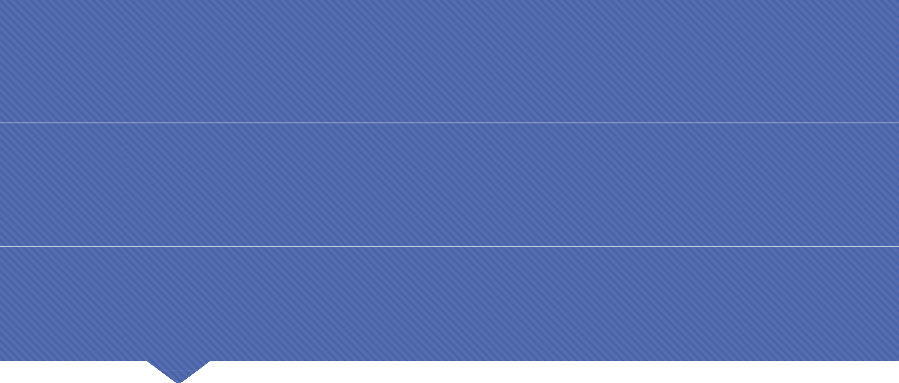
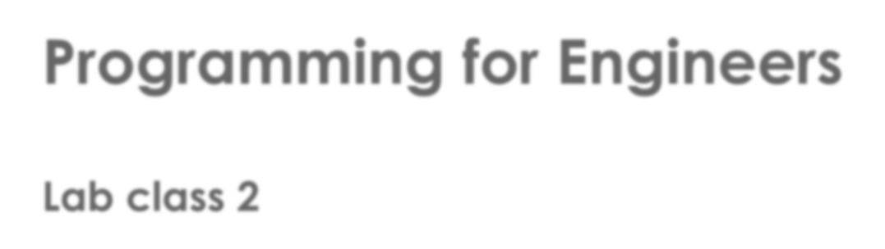
Programming for Engineers
Lab class 2

Slide 2
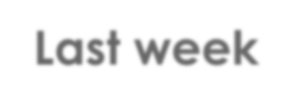
Last week
The basics
RAM
CPU
Program
Instructions
Program Data
Arithmetic Unit
 |  |  |  | Control Unit
Inputs
 Basic concepts of
computing and programming
Variables, constants and Operators
Basic datatypes
Outputs
Operating System and other programs
 int
 float
double
 char
 void

Free
int number;
number = 20;
number = 20 + 5; number = number + 8;
RAM
33

Slide 3
Last week
Making choices
 Making choices: conditional control structures
 If-else
instruction1
Yes
?
No
instruction2
instruction3

Slide 4
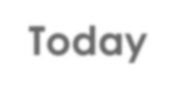
Today
More choices, handling of text data, arrays
 Making choices: conditional control structures
 If-else if, switch
 More operators
 Relational operators
 Logical operators
 More data types
 Array
 Strings: arrays of characters
 Escape sequences
instruction1
Yes
?
No
instruction2
instruction3

Slide 5
Today
Grouping of data & Loops
instruction1
 Grouped data
 Loops
 for
 while
 do-while
No
?
Yes
instruction2
instruction3

Slide 6
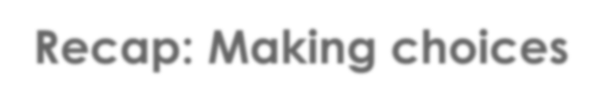
Recap: Making choices
The flow of control
 By default, instructions in a C program will be carried out one after the other
 This order of execution is important to ensure the proper running of the program
start
#include <stdio.h>
If we wanted to implement an element of choice, i.e. code that represents alternative paths of execution,
how could we do this?
main() {
int i; i = 20; i++;
printf("%d", i);
getchar();
return 0; finish
}

Slide 7
Recap: Making choices
The flow of control
 We need to create alternative blocks of code and then determine by evaluating an
expression which of these blocks will be entered for execution.
In pseudo code: In C code:
Is this expression true?
if (some expression is true) then do the following
instructions here…
otherwise, do something else
other instructions here…
if (i == 20) {
true
printf("You entered 20");
}
else {
false
}
printf("You entered something else");

Slide 8
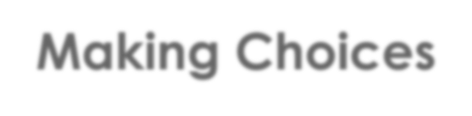
Making Choices
Control Structures: The Conditional Statement
 Simple if statement
if(money < 12)
{
printf("Insufficient funds");
}

Slide 9
Making Choices
Control Structures: The Conditional Statement
 if – else
if(money < 12)
{
printf("Insufficient funds");
}
else
{
printf("Thank you!");
}

Slide 10
Making Choices
Control Structures: The Conditional Statement
 if – else – if – else
if(money < 12)
{
printf("Insufficient funds");
}
else if(money > 12)
{
printf("That is very generous of you!");
}
else
{
printf("Thank you!");
}

Slide 11
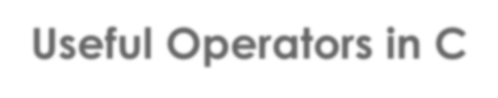
Useful Operators in C
Relational operators
 Two operands x and y are directly compared
Expression | What does it do?
x == y | Checks if x and y are equal and returns true if they are
x > y | Checks if x is greater than y and returns true if it is
x < y | Checks if x is less than y and returns true if it is
x >= y | Checks if x is greater than or equal to y and returns true if it is
x <= y | Checks if x is less than or equal to y and returns true if it is
x != y | Checks if x and y are equal and returns true if they are not

Slide 12
Useful Operators in C
Logical operators
Expression | How many operands? | What does it do?
!x | One | Performs logical NOT (negates current truth value)
x && y | Two or more | Performs logical AND (true if both true)
x || y | Two or more | Performs logical OR (true if at least one true)
Related truth tables
AND
OR
NOT
x | y | result
0 | 0 | 0
0 | 1 | 0
1 | 0 | 0
1 | 1 | 1
x | y | result
0 | 0 | 0
0 | 1 | 1
1 | 0 | 1
1 | 1 | 1
x | result
0 | 1
1 | 0

Slide 13
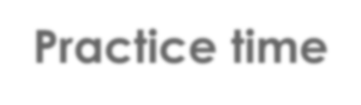
Practice time
Create a number-guessing game
Use a constant int target in your code to define the number that should be guessed.
Ask the user (your desk neighbour) to enter an int number.
Use relational operators / conditional statements to compare the number and target.
Determine how far the user is from the target, and whether they guessed high/low.
Display a verbal description to give the user a useful hint.
Congratulate the user if they guessed correctly.
(Tip: use while(target != number) to keep asking if the number is wrong)
Extension
1. Have the user guess two numbers and use logical operators to create a general response to each combined guess.
(e.g., "one is far too high and the other is a little bit too low")

Slide 14
Making Choices
Control Structures: The Conditional Statement
 switch
switch (any expression) {
case constant result1: instruction to run;
break;
case constant result2: instruction to run; break;
.
.
.
default: instruction to run if none of the above fire;
}

Slide 15
Making Choices
Control Structures: The Conditional Statement
 switch
switch (money) {
case 0 : printf("No money given!");
break;
case 12: printf("Thank you!");
break;
default: printf("That’s not the right amount!");
}
 We need to break the flow of execution after one of the expressions fires!

Slide 16
Practice time
Create a simple calculator program
Create a program that asks the user to enter two integers and a character. The numbers will be operands and the character should be either +, -, /, or * (addition, subtraction, division, multiplication)
Use a switch statement to process the arithmetic equation resulting from the inputs and print out the result on the console.

Slide 17
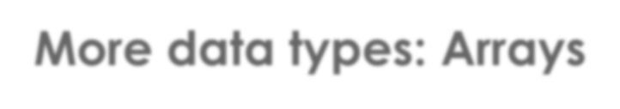
More data types: Arrays
What is an array?
 An array is a grouping of data of the same type.
 Arrays can have multiple dimensions
2-dimensional array
1-dimensional array

Slide 18
More data types: Arrays
How do arrays work?
size = 4
 An array stores a fixed number of elements
 Elements can be addressed using an index number
0
1
2
3
Maximum index = size - 1

Slide 19
More data types: Arrays
Syntax
 Declaration
size = 4
data_type identifier[size];
e.g.,
int numbers[4];
0
1
2
3
Use square brackets here
Maximum index = size - 1

Slide 20
More data types: Arrays
Syntax
 Declaration
data_type identifier[size];
e.g.,
4 | 12 | 3 | 1
data
int numbers[4];
index
0
1
2
3
 Declaration & instant initialisation
int numbers[4] = {4,12,3,1};
Note: use "curly" brackets here

Slide 21
More data types: Arrays
Code Example
int numbers[4] = { 0 };
0 | 0 | 0 | 0
0
1
2
3

Slide 22
More data types: Arrays
Code Example
int numbers[4]; numbers[0] = 10;
numbers[1] = 45;
10 | 45 | … | …
0
1
2
3

Slide 23
More data types: Arrays
Code Example
int numbers[4]; numbers[0] = 10;
numbers[1] = 45;
numbers[4] = 12;
10 | 45 | … | …
0
1
2
3
What is going to happen here?

Slide 24
More data types: Arrays
Code Example
10 | 45 | … | …
int numbers[4];
numbers[0] = 10;
0
1
2
3
numbers[1] = 45;
numbers[4] = 12;
Index out of defined bounds!
This can have unpredictable effects - make sure only valid indices are used!

Slide 25
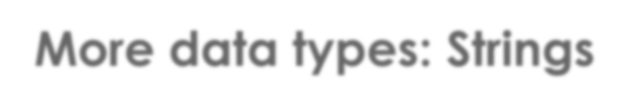
More data types: Strings
Working with Strings
 Unlike other programming languages, C does not handle strings of text as a separate data type
 Strings are handled as arrays of characters
char c;
// a single character
char s[23];
// a string of 23 characters

Slide 26
More data types: Strings
Working with Strings
 Unlike other programming languages, C does not handle strings of text as a separate data type
 Strings are handled as arrays of characters
char c; | // | a single character
char s[23]; | // | a string of 23 characters
c = 'A'; | // | single quotation marks
char s[] = "I am a string";
// note the ""

Slide 27
More data types: Strings
Working with Strings
 Unlike other programming languages, C does not handle strings of text as a separate data type
 Strings are handled as arrays of characters
char c; | // | a single character
char s[23]; | // | a string of 23 characters
c = 'A'; | // | single quotation marks
I |  | a | m | …
0
1
2
3
4
char s[] = "I am a string";
// note the ""

Slide 28
More data types: Strings
Working with Strings
 String functions are available by including the header string.h
Look up the header summary in the C API and find out how to use the following
functions
strcpy
strlen
strchr
strstr

Slide 29
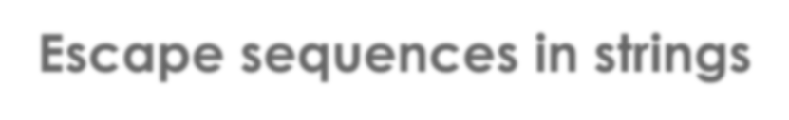
Escape sequences in strings
What are escape sequences?
 Special characters inserted within a string
 Get translated into special symbols or functionality
 Start with the back-slash symbol (\), followed by the escape symbol
e.g. \n creates a new line, as in
printf("Hello\nWorld!");
Any other, ordinary characters around an escape sequence will be displayed as usual – including “ ” (space) characters!

Slide 30
Escape sequences in strings
Common escape sequences
Escape seq. | What does it do?
\a | Beep
\n | New line
\t | Tab stop
\b | Backspace
\r | Carriage return
\” | Double quotation mark character
\’ | Single quotation mark character
\\ | Back-slash character

Slide 31
Practice time
Working with Strings
Create two strings
Initialise the first string and copy its contents to the other string (make them identical). Display both strings, separated by a line-break (\n).
Compute the length of the first string and print the number to the screen.
Experiment with the other two functions What do they do? Consult the API to find out
Implement an example that demonstrates how both work.
Test your example with different values, e.g. what happens if you use an
empty string?
Improve your number-guessing game from earlier by storing text responses in string variables. Use and/or concatenate their values as required.

Slide 32
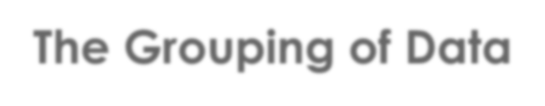

The Grouping of Data
Why would we want to group data?
There are many applications
 Library catalogue
 Online shopping basket
 Phone number directory
 Address book / Diary
 Representing strings (in C)
 Knowledge representation for Problem-solving

Slide 33
The Grouping of Data
What can we do with grouped data?
Common operations
 Adding an item to a group
 Retrieving a specific item (read data)
 Modifying a single data item or all items in a group
 Removing a data item / all items
from a group

Slide 34
The Grouping of Data
What can we do with grouped data?
Common operations, e.g. in database applications
 Create
 Read
 Update
I’m a
database
 Delete
I am a program that uses the database

Slide 35
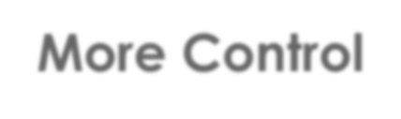
More Control
Loops
 We often want to perform an action multiple times
 Most programming languages include loop statements to make this possible
 Basically, there are three kinds of loops in C:
while loop
do-while loop
for loop

Slide 36
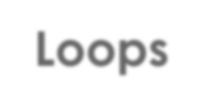
Loops
While loop
 No explicit control variable, only a condition
 Performance depends on the condition
 Danger of infinite loops if condition never yields false!
while(condition)
{
// instructions to be repeated
// important: include an instruction that affects the condition!
}

Slide 37
Loops
While loop
 No explicit control variable, only a condition
 Performance depends on the condition
 Danger of infinite loops if condition never yields false!
int i = 0; 1 int k = 2; while( i < k )
{
printf("Turn %d", i); i++;
}
i = 0
k = 2

Slide 38
Loops
While loop
 No explicit control variable, only a condition
 Performance depends on the condition
 Danger of infinite loops if condition never yields false!
int i = 0; 1
int k = 2;
while( i < k ) 2 true
{
printf("Turn %d", i); i++;
}
i = 0
k = 2

Slide 39
Loops
While loop
 No explicit control variable, only a condition
 Performance depends on the condition
 Danger of infinite loops if condition never yields false!
int i = 0; 1
int k = 2; while( i < k ) 2
{
printf("Turn %d", i); 3
i = 1
i++;
4
}
k = 2

Slide 40
Loops
While loop
 No explicit control variable, only a condition
 Performance depends on the condition
 Danger of infinite loops if condition never yields false!
int i = 0; 1
int k = 2; while( i < k ) 2
{
5 true
i = 1
printf("Turn %d", i); 3
i++;
4
}
k = 2

Slide 41
Loops
While loop
 No explicit control variable, only a condition
 Performance depends on the condition
 Danger of infinite loops if condition never yields false!
int i = 0; 1
int k = 2; while( i < k ) 2
{
5
i = 2
printf("Turn %d", i); 3 6
i++;
4 7
}
k = 2

Slide 42
Loops
While loop
 No explicit control variable, only a condition
 Performance depends on the condition
 Danger of infinite loops if condition never yields false!
int i = 0; 1
int k = 2; while( i < k ) 2
{
5
8 false
3 6
i = 2
printf("Turn %d", i);
i++;
4 7
}
exit loop
k = 2

Slide 43
Loops
Do-While loop
 Similar to while-loop with the exception that the loop body is executed once before the condition is checked
int i = 200;
do {
printf("Enter a number above 100 : ");
scanf("%d", &i);
}
while( i <= 100);
Semicolon here!

Slide 44
Loops
For loop
 Initialises a control variable; matches it against a condition; modifies the control variable after each loop iteration
 Performance depends on the value of the control variable / condition
for(initialisation; condition; post-loop action)
{
// instructions to be repeated
}

Slide 45
Loops
For loop
 Initialises a control variable; matches it against a condition; modifies the control variable after each loop
 Performance depends on the value of the control variable / condition
int index, k=2;
1
for(index=0; index < k; index = index + 1)
{
printf("Turn %d", i);
}
index = 0
k = 2

Slide 46
Loops
For loop
 Initialises a control variable; matches it against a condition; modifies the control variable after each loop
 Performance depends on the value of the control variable / condition
int index, k=2;
1
2 true
for(index=0; index < k; index = index + 1)
{
printf("Turn %d", i);
}
index = 0
k = 2

Slide 47
Loops
For loop
 Initialises a control variable; matches it against a condition; modifies the control variable after each loop
 Performance depends on the value of the control variable / condition
int index, k=2;
1
2
for(index=0; index < k; index = index + 1)
{
index = 0
printf("Turn %d", index); 3
}
k = 2

Slide 48
Loops
For loop
 Initialises a control variable; matches it against a condition; modifies the control variable after each loop
 Performance depends on the value of the control variable / condition
int index, k=2;
1
2 4
for(index=0; index < k; index = index + 1)
{
index = 1
printf("Turn %d", index); 3
}
k = 2

Slide 49
Loops
For loop
 Initialises a control variable; matches it against a condition; modifies the control variable after each loop
 Performance depends on the value of the control variable / condition
int index, k=2;
1
2 5 true 4
for(index=0; index < k; index = index + 1)
{
index = 1
printf("Turn %d", index); 3
}
k = 2

Slide 50
Loops
For loop
 Initialises a control variable; matches it against a condition; modifies the control variable after each loop
 Performance depends on the value of the control variable / condition
int index, k=2;
1
2 5 4
for(index=0; index < k; index = index + 1)
{
index = 1
printf("Turn %d", index); 3 6
}
k = 2

Slide 51
Loops
For loop
 Initialises a control variable; matches it against a condition; modifies the control variable after each loop
 Performance depends on the value of the control variable / condition
int index, k=2;
1
2 5 4 7
for(index=0; index < k; index = index + 1)
{
index = 2
printf("Turn %d", index); 3 6
}
k = 2

Slide 52
Loops
For loop
 Initialises a control variable; matches it against a condition; modifies the control variable after each loop
 Performance depends on the value of the control variable / condition
int index, k=2;
1
2 5 8 false
4 7
for(index=0; index < k; index = index + 1)
{
index = 2
printf("Turn %d", index); 3 6
}
exit loop
k = 2

Slide 53
Loops
For loop
 Initialises a control variable; matches it against a condition; modifies the control variable after each loop
 Performance depends on the value of the control variable / condition
int i, k=2;
for(i=0; i < k; i++)
{
printf("Turn %d", i);
}
Shorter, equivalent code

Slide 54
Practice time
Create a program that can add five integers
Create an array of integers to store five numbers in
Use a loop of your choice to ask the user to enter five successive integers and store these in the array
Use another kind of loop to iterate over and add all numbers stored in the array
Print out on screen the sum
Extension
Make the program "talk" a bit more about what it is doing:
E.g., output details about calculation steps and intermediate results.

Slide 55
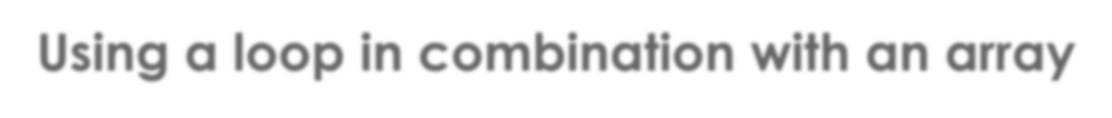
Using a loop in combination with an array
Loops & Arrays: Part 1
 Loops are an excellent way of iterating through the contents of an array
 We can use the index (i) of a for-loop to access successive array items
and also to print out status information
int i;
int numbers[5] = { 0 };
printf("Please enter five integers\n\n");
for(i = 0; i <=4; i++) // for-loop, allows i to be between 0 and 4
{
printf("Number %d: ", i+1); // add 1 for sensible output
scanf("%d", &numbers[i]);
}

Slide 56
Using a loop in combination with an array
Loops & Arrays: Part 2
 Loops are an excellent way of iterating through the contents of an array
 We can also use variables manipulated within a while-loop to access specific array items
int k = 0, result = 0;
int length = sizeof(numbers) / sizeof(int); // compute array length
while( k < length) // k must be strictly less than length (maxIndex+1==length)
{
printf("\nI'm adding %d to %d", numbers[k], result); result += numbers[k]; // same as result=result+numbers[k] printf(" which gives %d.", result);
k++;
}
printf("\n\nThe sum of all numbers is: %d", result);

Slide 57
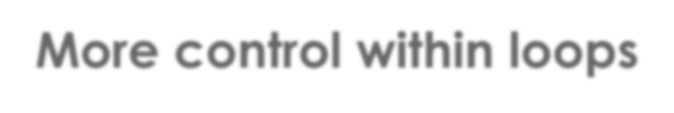
More control within loops
break & continue
We already know break from the switch statement – it interrupts execution within the current control structure and makes the program continue with the following instruction.
Similarly, break will stop the loop entirely, no matter how many iterations would normally be left to do, and execution will continue with the next instruction after the loop.
continue only skips the current turn from the point at which it is placed and will trigger another evaluation of the condition.
In a for-loop, the post-loop action (usually incrementing the control variable) will be run before another evaluation is made.
Experiment with break and continue in your number-adding program.

Slide 58
Practice time
Create a program that can add five integers
Create an array of integers to store 100 numbers in
Use a loop of to store 100 integers and store these numbers in the array
Use another kind of loop to iterate over and add all numbers with even index stored in the array
if the sum is greater than a fixed nmuber then exit the loop
Print out on screen the sum and the last added number's index before exit from the last loop.
Extension
Make the program "talk" a bit more about what it is doing:
E.g., output details about calculation steps and intermediate results.

Slide 59
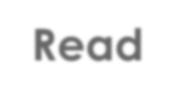
Read
 Kernighan and Ritchie
 Section 1.6, 2.5, 2.6, 2.8, 2.11, 3.4 - 3.7

Slide 60
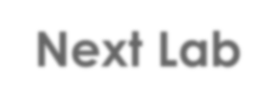
Next Lab
 Functions
 Problem-solving

